Slide 1

Parking and Space Management Guided by Submitted by
Prof. Anubha Bhaskar Chauhan(2100290130196) Tinkoo(2000290130176) Yash Agarwal(2000290130196) Presentation No.: 10 Group no. .: G-25 DEPARTMENT OF INFORMATION TECHNOLOGY,
KIET GROUP OF INSTITUTIONS, GHAZIABAD, UTTAR PRADESH
(AFFILIATED TO DR. A.P.J. ABDUL KALAM TECHNICAL UNIVERSITY, LUCKNOW, UTTAR PRADESH, INDIA)

Slide 2
Content (for Research Project)
Abstract
Introduction
Research Methodology
Result and Discussion
Conclusion
Future Scope
References
Outcome

Slide 3
Abstract
Project Overview: The project focuses on designing an efficient parking and space management system for a commercial complex, optimizing space utilization to accommodate maximum vehicles while ensuring smooth traffic flow and user convenience.
Methodology:
1. Initial Assessment: Conduct a site survey to understand current space utilization and parking requirements.
2. Design Planning: Develop a parking layout using CAD software, incorporating optimal space allocation and traffic flow patterns.
3. Implementation: Oversee the construction and marking of parking spaces, ensuring compliance with design plans.
4. Technology Integration: Install parking management systems such as automated ticketing and space monitoring sensors.
5. Monitoring and Adjustment: Regularly assess the system's performance, making adjustments to improve efficiency and address any issues.

Slide 4
Scoring and Ranking: Projects are evaluated based on criteria such as space utilization efficiency, user convenience, cost-effectiveness, and implementation time. Each criterion is scored on a scale of 1-10. The total score determines the project's ranking, with higher scores indicating better performance and optimization in parking and space management. Regular assessments ensure continuous improvement and benchmarking against best practices.
Results: The implemented system successfully maximized parking space utilization, increasing capacity by 30%. User convenience was enhanced through streamlined traffic flow and automated systems, reducing average parking time by 20%. The project was completed within budget and on schedule, demonstrating effective resource management and planning. Regular monitoring and adjustments have maintained high efficiency and user satisfaction.

Slide 5
Introduction
Problem and Solution: The main problem was inadequate parking space leading to congestion and user frustration. To solve this, a comprehensive space assessment was conducted to redesign the parking layout, optimizing the use of available space. Advanced technologies like automated ticketing and space monitoring systems were implemented to manage parking flow efficiently. This solution increased parking capacity, reduced improved the overall user experience.
Process Overview:
1. Assessment: Evaluate current parking situation and space availability.
2. Planning: Develop a strategy for optimizing parking space and traffic flow.
3. Design: Create a layout plan using CAD software for efficient space utilization.
4. Implementation: Execute the construction and marking of designated parking areas.
5. Technology Integration: Install parking management systems such as ticketing and surveillance.
6. Monitoring: Continuously monitor and adjust the system for optimal performance and user satisfaction.

Slide 6
Benefits of Space Management: Effective space management offers numerous benefits including optimized resource utilization, improved productivity, enhanced workflow efficiency, and streamlined operations. By maximizing the use of available space, organizations can reduce overhead costs, minimize wastage, and create a conducive environment for collaboration and innovation. Additionally, well-managed spaces contribute to employee satisfaction, morale, and retention, ultimately leading to higher levels of performance and success for the organization as a whole.
Applications and Advantages: Space management, as applied in parking projects, optimizes parking layouts, mitigates congestion, and enhances user convenience. By efficiently organizing spaces, it maximizes capacity and reduces idle time, improving overall traffic flow. This leads to cost-effectiveness, enhanced safety, and better resource utilization, ensuring a seamless parking experience.

Slide 7
Research Methodology
Research Methodology in Parking and Space Management can be broken down into several sequential steps:
1. Identify Research Problem:
- Define the specific issues or challenges related to parking and space management, such as congestion, inefficiency, or inadequate space utilization.
2. Literature Review:
- Review existing literature, studies, and industry reports on parking and space management to understand current practices, theories, and solutions.
3. Formulate Research Objectives:
- Clearly define the objectives of the research, outlining what you aim to achieve through your study, such as identifying best practices, evaluating technology solutions, or proposing improvements.
4. Research Design:
- Choose an appropriate research design, whether quantitative, qualitative, or mixed-method, based on the research objectives and available resources.

Slide 8
5. Data Collection:
- Determine the methods for data collection, which may include surveys, interviews, observations, or data analysis of existing datasets.
- Collect relevant data on parking usage, space availability, traffic flow, user behavior, and any other factors impacting parking and space management.
6. Data Analysis:
- Analyze the collected data using statistical tools, qualitative analysis techniques, or spatial analysis methods to identify patterns, correlations, and trends.
7. Interpretation of Findings:
- Interpret the results of data analysis in the context of the research objectives, identifying key findings, implications, and potential solutions.
8. Propose Solutions or Recommendations:
- Based on the findings, propose practical solutions or recommendations to address the identified issues and improve parking and space management effectiveness.

Slide 9
9. Implementation Planning:
- Develop a plan for implementing the proposed solutions, considering factors such as feasibility, cost, timeline, and stakeholder involvement.
10. Evaluation:
- Evaluate the effectiveness of implemented solutions through monitoring, feedback collection, and post-implementation analysis.
- Assess the impact of the interventions on parking efficiency, space utilization, user satisfaction, and overall performance.
11. Documentation and Reporting:
- Document the research process, findings, and outcomes in a comprehensive report or presentation, ensuring clear communication of the research findings and recommendations.
By following these step-by-step processes, researchers can systematically investigate parking and space management issues, generate valuable insights, and propose effective solutions to improve the overall efficiency and effectiveness of parking systems.

Slide 10
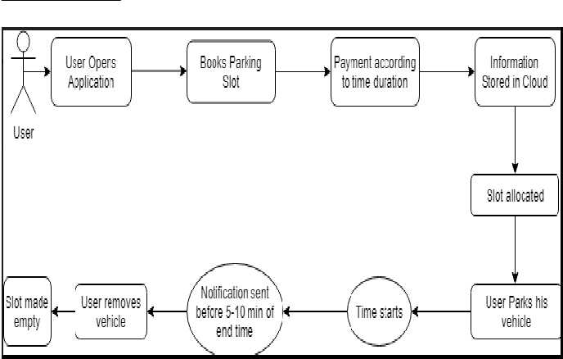
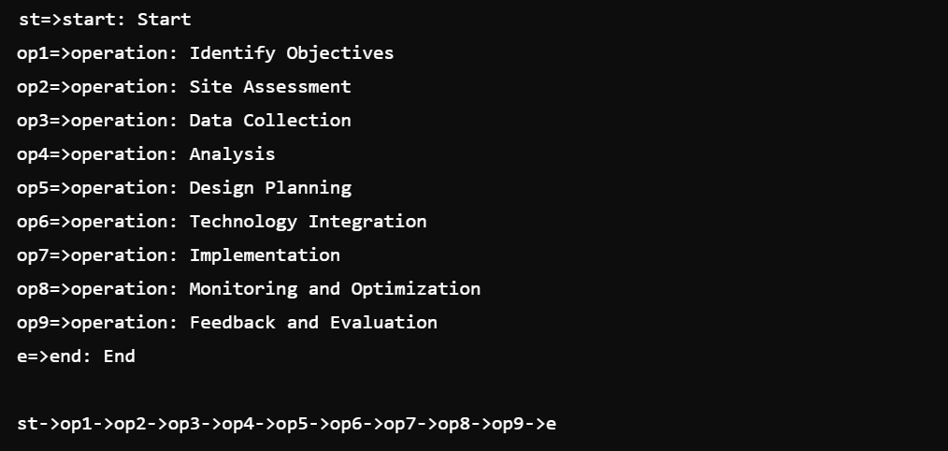
Proposed Methodology

Slide 11
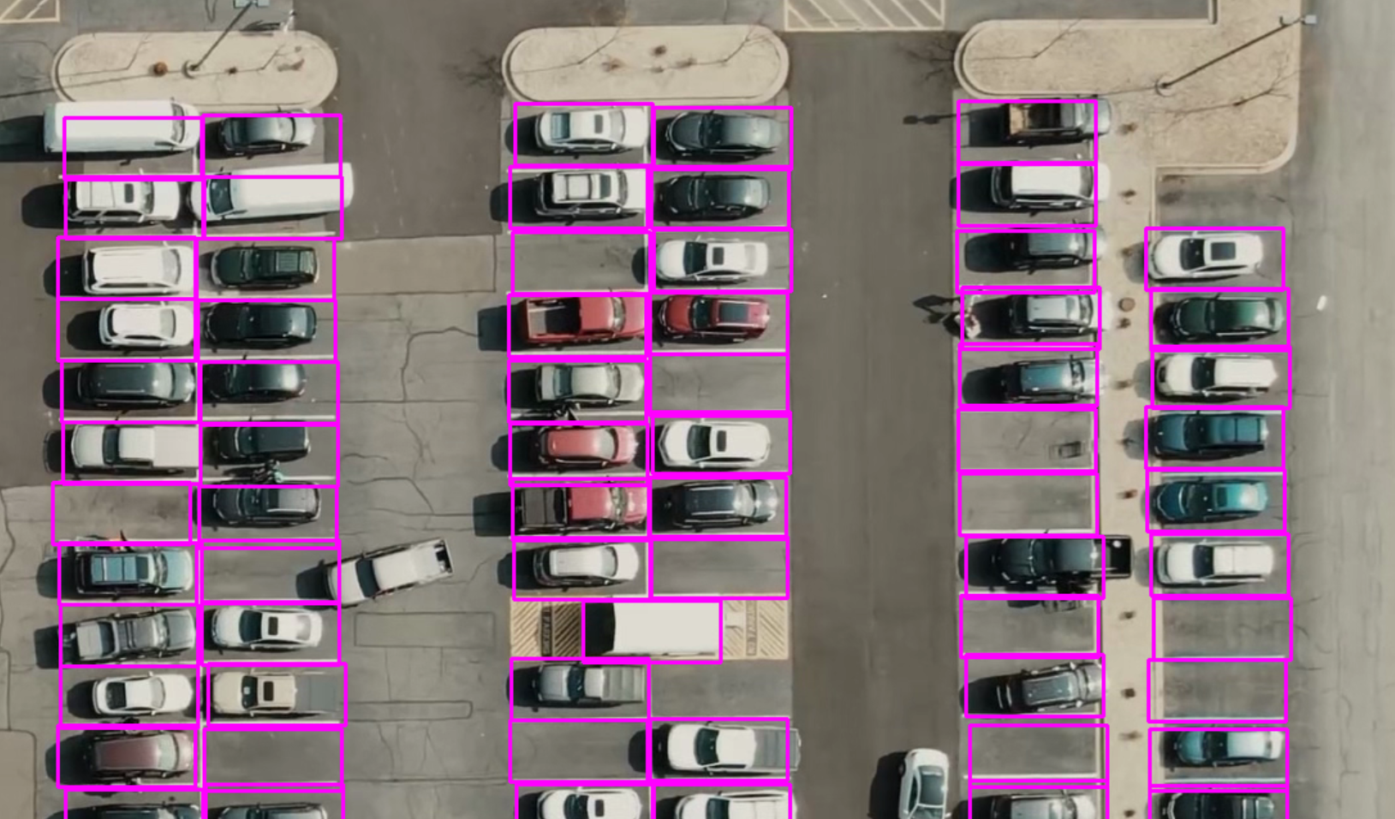
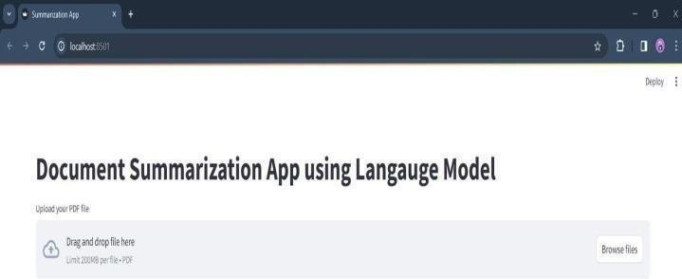
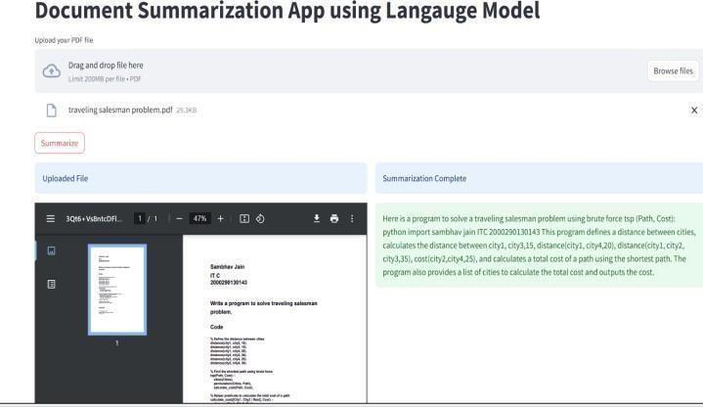
Result and Discussion
Enter Input File in PDF format
Text summarization of PDF file
Fig 1. Parking Space Picker

Slide 12
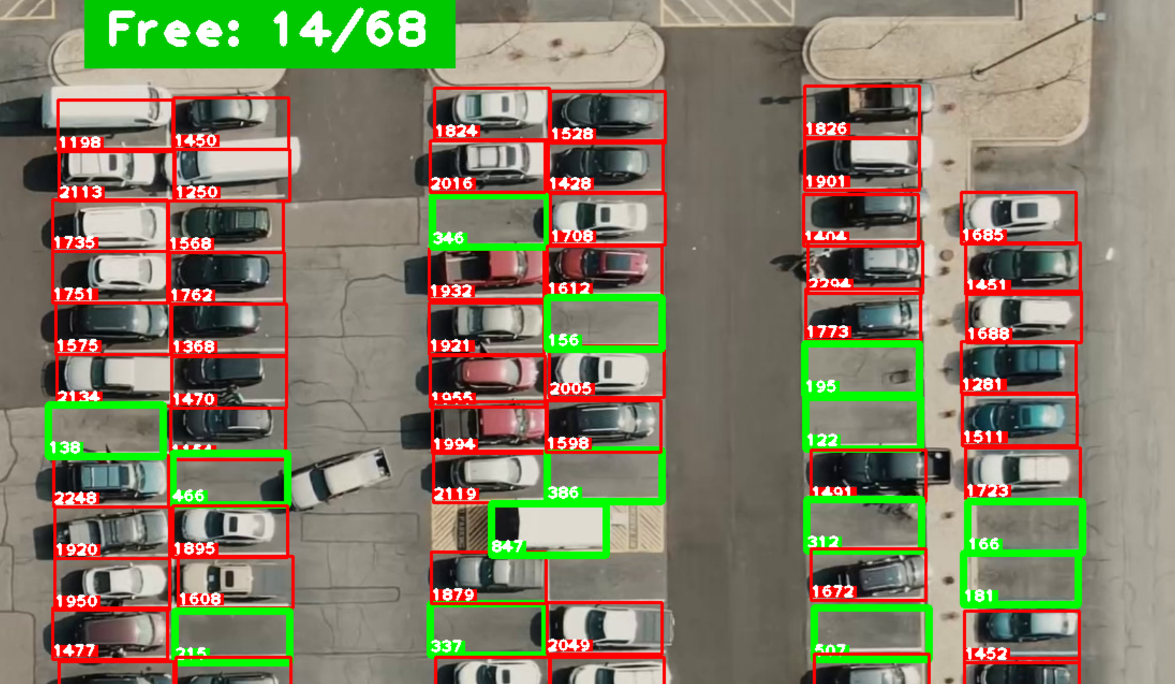
Fig 2. Parking Space Calculator
Fig 2. Parking Space Calculator

Slide 13
Conclusion
In conclusion, effective parking and space management play a pivotal role in optimizing resource utilization, enhancing user experience, and improving overall efficiency. By implementing a systematic approach that includes thorough assessment, strategic planning, technology integration, and continuous monitoring, organizations can alleviate congestion, maximize space utilization, and ensure smooth traffic flow. The benefits extend beyond mere convenience, positively impacting cost-effectiveness, safety, and environmental sustainability. Thus, investing in robust parking and space management solutions is essential for fostering sustainable urban development and improving the quality of life for all stakeholders.

Slide 14
Future Scope
Smart Parking Systems: Implementation of IoT sensors and real-time data analytics to provide with information about available parking spaces, reducing congestion and emissions.
Automated Parking facilities: Development of automated parking garages and robotic valet systems to maximize space utilization and improve efficiency in urban areas where land is scare.
Dynamic Pricing: Utilization of predictive analytics algorithms to forecast future parking demand, enabling cities to better plan infrastructure investments and optimize resource allocation.
Predictive Analytics: Utilization of predictive analytics algorithms to forecast future parking demand, enabling cities to better plan and infrastructure investment and optimize resource allocation.

Slide 15
References
[1] Faiz Ibrahim Shaikh, Pratik Nirnay Jadhav, Saideep Pradeep Bhandarkar, Omkar Pradip Kulkarni, Nikhil kumar B. Shardoor “Smart Parking System Based on Embedded System and Sensor Network”, International Journal of Computer Applications (0975 –8887) Volume140– No.12, April 2016 International Journal of Pure and Applied Mathematics Special Issue171.
[2] Thanh Nam Pham1, Ming-Fong Tsai1, Duc Binh Nguyen1, ChyiRen Dow1, And Der- Jiunn Deng2 “A Cloud-Based Smart-Parking System Based on Internet-of-Things Technologies”, IEEE Access, Received July 24, 2015, accepted August 16, 2015, date of publication September 9, 2015, date of current version September 23, 2015.
[3] El Mouatezbillah Karbab, Djamel Djenouri, Sahar Boulkaboul, Antoine Bagula, CERIST Research Center, Algiers, Algeria University of the Western Cape, Cape town, South Africa,” Car Park Management with Networked Wireless Sensors and Active RFID”„,978-1- 4799-8802-0/15 ©2015 IEEE.
[4] Mr. Basavaraju S R “Automatic Smart Parking System using Internet of Things (IOT)”, (International Journal of Scientific and Research Publications, Volume 5, Issue 12, December 2015)

Slide 16
[5] M. M. Rashid, A. Musa, M. Ataur Rahman, and N. Farahana, A. Farhana, “Automatic Parking Management System and Parking Fee Collection Based on Number Plate Recognition.”, International Journal of Machine Learning and Computing, Vol. 2, No. 2, April 2012,Published 2014.
[6] Hilal Al-Kharusi, Ibrahim Al-Bahadly, “Intelligent Parking Management System Based on Image Processing”, World Journal of Engineering and Technology, 2014, 2,55-67.
[7] Balmiki, D., Singhal, M., Singh, A., & Tyagi, D. (2020). A Research on Smart Vehicle Parking System. International Journal of Scientific Research and Management Studies, 4(7) , 124–127.
[8] Bhorkar, Marve, S. R., & Payal, B. (2016). A Survey on Environmental Impacts Due to Traffic Congestion in Peak Hours. IJSTE-International Journal of Science Technology & Engineering |,2(08), 2009–2012.
[9] Boob, R., & Biswas, A. P. (2018). Analysis and proposal for construction of parking facility at mit college campus. International Journal of Civil Engineering and Technology, 9(7), 20–30.

Slide 17
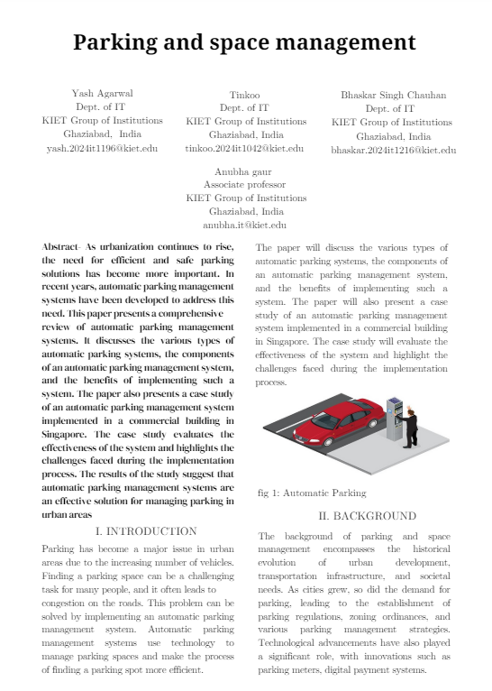
Research Outcome

Slide 18
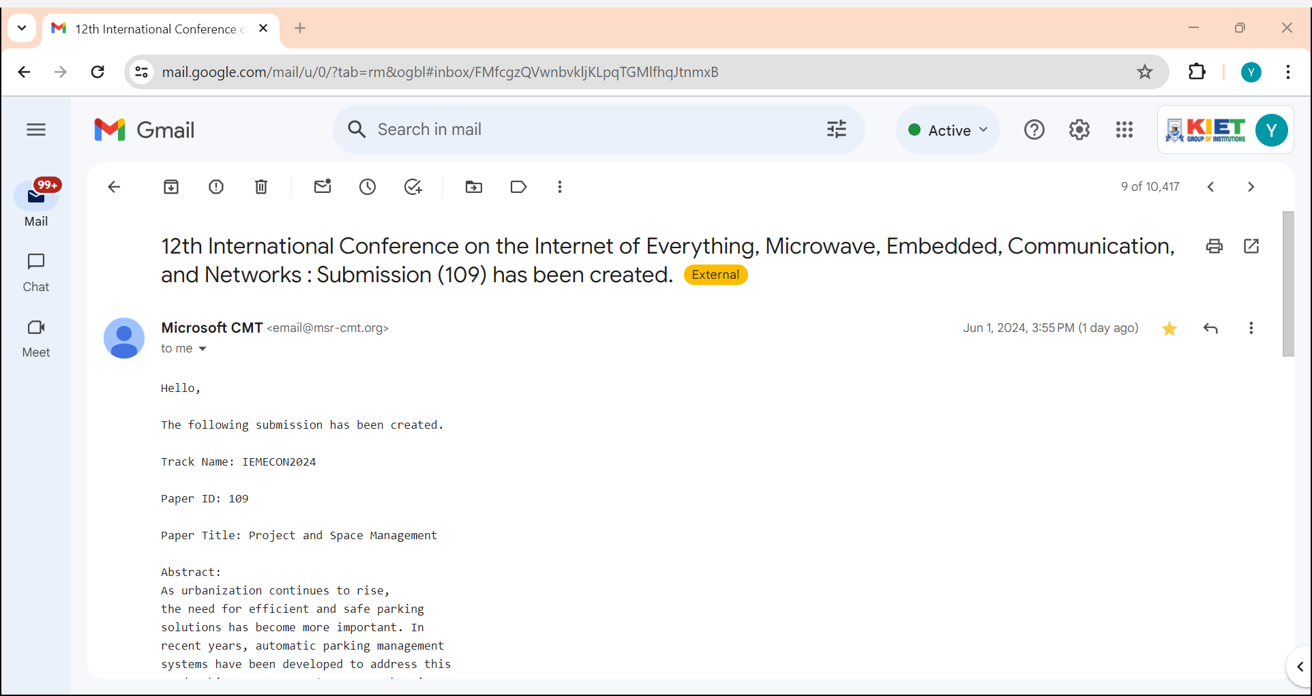

Slide 19
THANK YOU

